Slide 1
Cyclistic Bike
how does a bike-share navigate a speedy success
Date: 17 Nov 2021

Slide 2
Overview
Description
Design a marketing strategy aiming to convert casual riders into annual members. In order to maximize the benefit of this marketing strategy, we will need to explore 3 main topics:
How do members differ in behavior from casual riders
Why would casual riders buy an annual subscription
How can Cyclistic Bike as a company use digital media to influence casual riders.
Task
In this presentation, we will focus more on the first topic analyzing the different behaviors between member and casual riders.

Slide 3
Data info.
Information on the Data Used
This case study sheds the light on the different behaviors between members and casual users by analyzing data that have the following characteristics:
Data records of bike trips in the past year have been used, the data is split in 4 files, 1 for each quarter.
The data used has been made available by Motivate International Inc. under this license.
Data are stored in a shared folder where only members of the working team are granted access.

Slide 4
Data Manipulation
A total of 3,879,822 bike trips have been analyzed. 4 files aggregated into 1 file and few data manipulation have been applied to ensure data consistency:
R Programming has been used for compiling the files and then Tableau was used for data analysis.
Column names have been unified between the 4 files.
Added few columns showing the trip duration and day of week, Month and year
Removed lines with negative trip duration (bike maintenance trips to HQ).
Unified subscription type (subscriber & member = member, casual & customer = casual)

Slide 5
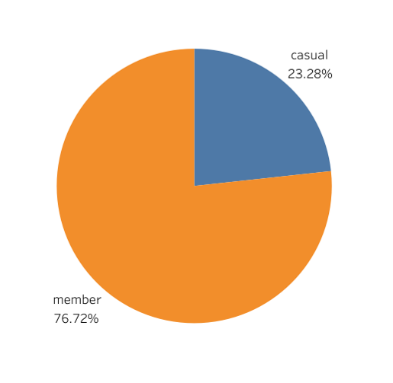
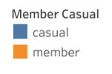
Data Analysis Total Number of Rides per rider type
Total Number of Trips in 1 year among member riders are 76.7% of the total number of trips

Slide 6
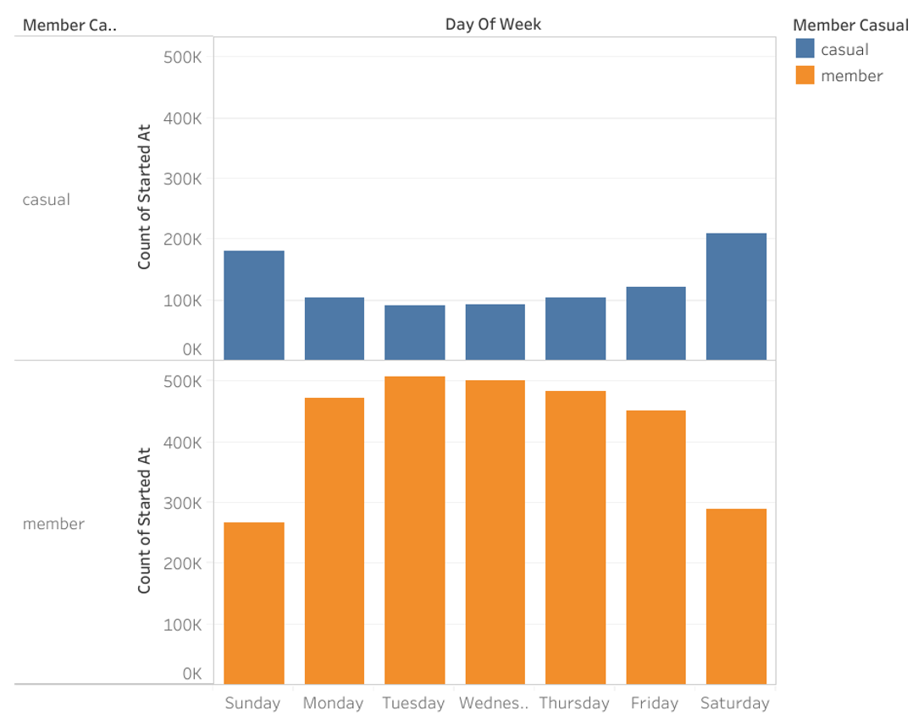
Data Analysis Total Number of Rides per weekday per type of subscription
Members: number of rides significantly increases in working days among members while decreases in weekend.
Casual: The opposite for casual riders, number of rides almost doubles in weekends while decreases during working days.
Total number of rides among members higher than total number of trips among casual riders in all weekdays.

Slide 7
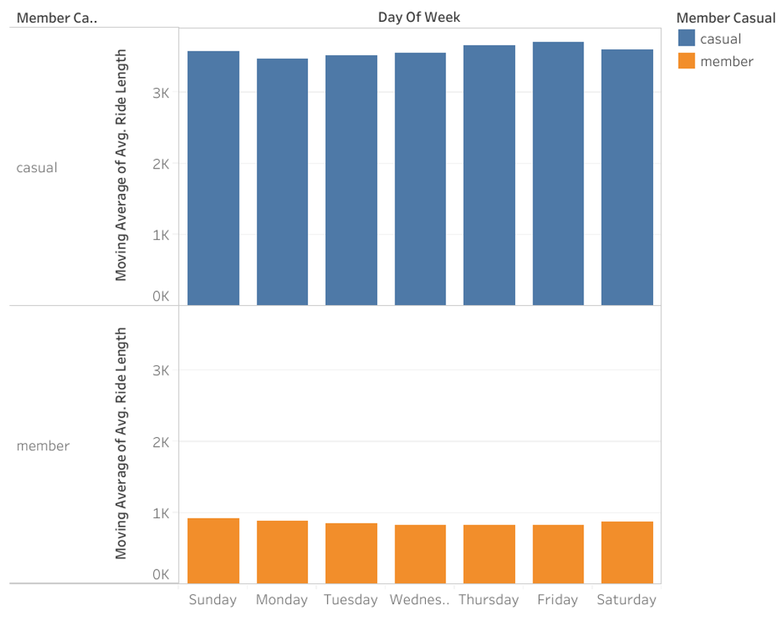
Data Analysis Total average duration of rides per weekday per type of subscription
Members & Casual: average duration of rides does not notably change in different weekdays but is clear that the average ride duration among members is lower than that of the casual riders.

Slide 8
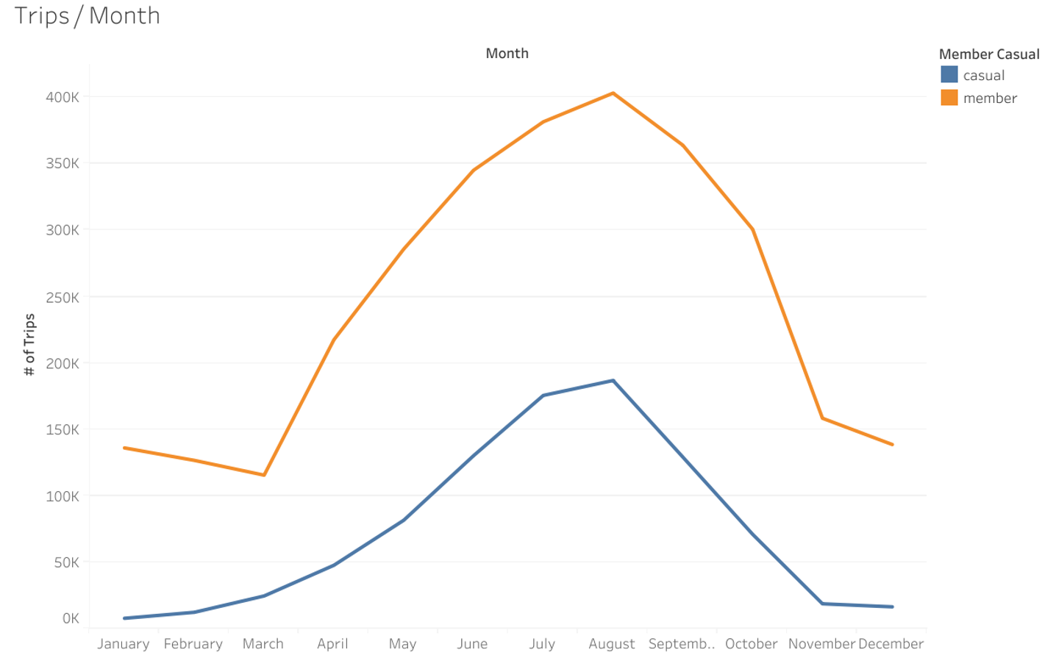
Data Analysis Total Rides & Avg duration of rides per month per rider type
Highest number of rides are recorded in the months of July, Aug & Sept for both members and casual riders. Number of member rides are higher in all months.
Lowest number of rides recorded in the colder months of December, January & February
This leads to another analysis of Monthly Trips vs Average monthly Temperature in Chicago.

Slide 9
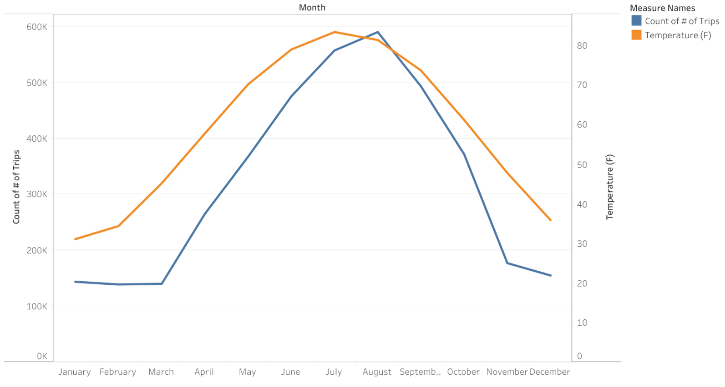
Data Analysis Total Rides per month vs average monthly temperature
Highest number of trips recorded in the hottest months.
Temperature can be a factor of increased trips but not necessary the cause.
Desclaimer, Average monthly records downloaded from rssweather website.

Slide 10
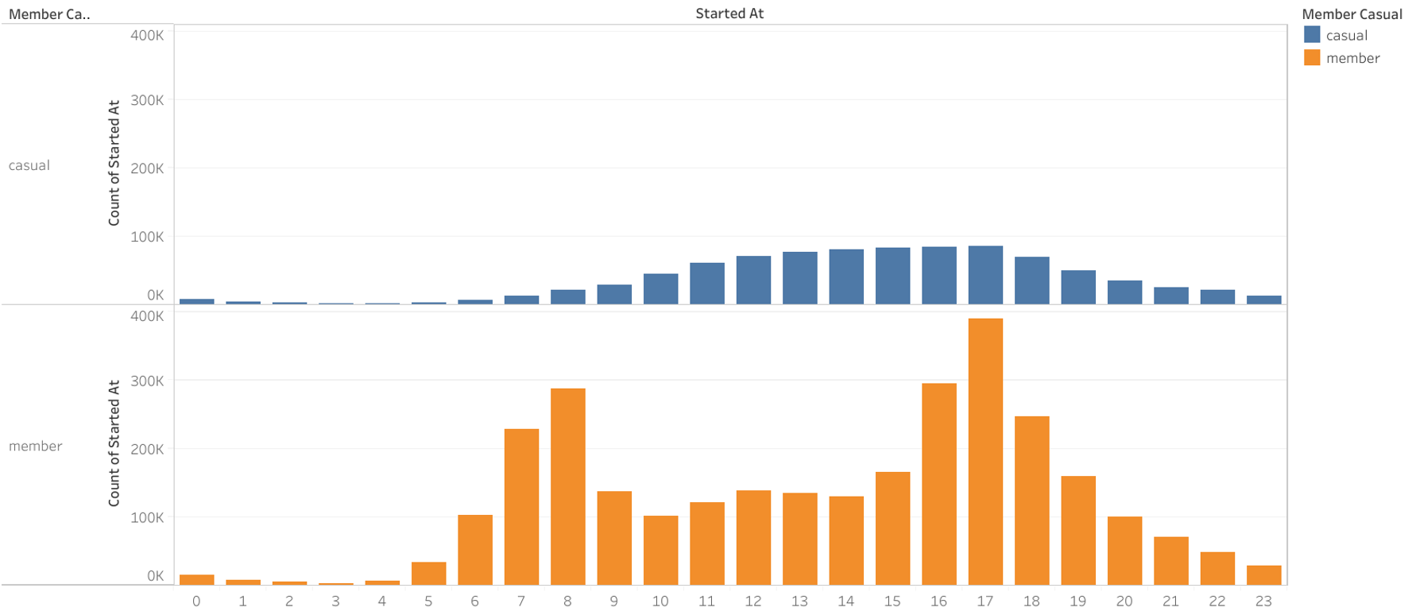
Data Analysis Total rides per hour per type of subscription
Members : total number of rides increases in the work commute hours (7-9am) and (4-6pm) with highest record at 5pm.
Casual : total number of rides are flat and increases gradually from 10am to 6pm. Highest record at 5pm

Slide 11
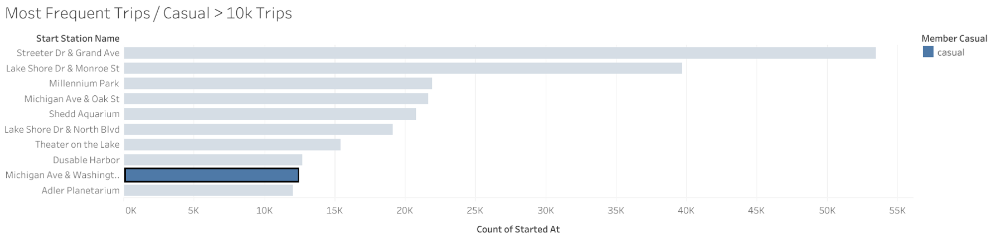
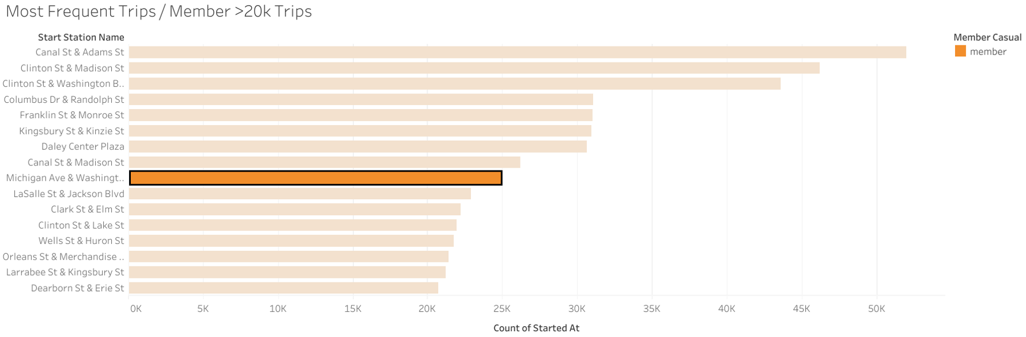
Data Analysis most frequent trips (same start & end station)
Few trips with same start and end station are recorded among member and casual riders.
One Trip in particular recorded more than 10k Trips among casual riders and more than 20k Trips among member riders.
Michigan Ave – Washington

Slide 12
Summary and Recommendations
The number of rides among members are more during working days and less during weekend, while it is the opposite for the casual riders. It is also noted that the number of rides among casual and member riders increase in the period between April and September (hotter months) while decrease from Oct to March.
Number of Trips increases among member riders in the work commute hours.
Average trip duration is generally much longer among casual riders than that of the members.
In converting the casual riders into members, it is recommended to take in consideration the following in the marketing campaign:
Intensify the marketing campaign addressing casual riders during weekdays as those are possibly among the riders that use the bike for a similar purpose as member riders.
Amplify the marketing campaign during work commute hours (6-9am & 4-6pm) with highest at 5pm as those casual riders in these hours are more likely to use bikes to commute to work.
Extensive marketing campaign addressing casual riders from April to September, as those months records significantly higher number of riders
Identify the casual riders using the trip that starts from (Michigan Ave) and ends at (Washington Ave) as those could possibly use the bike for the same purpose as member riders.

Slide 13
Suggestions & Next steps
Modify the mobile app to record more accurate data on location of start and end of the trips
Maintenance trips should not be recorded in the dataset to be used next time for analysis as this was causing misleading info.
Next Steps for a better analysis if given the time to do it:
Compare the number of trips per month with other weather conditions
Compare the number of trips per month with number of tourists
Identify more Trips where both casual and member riders use the same start and end stations as in this analysis I focused more on the highest significant trip.

Slide 14
Question & answer

